Slide 1




Relations Can Speak
How Graph Neural Network Works in AI Field
演讲人：Thinker
主持人：Guinyの时光(格物设科普平台&逸仙工作室)
2022-08-27

Slide 2
Outline
What is Relational Data
Adjacency Matrix and Graph
Fourier Transform on Graph
Graph Neural Network
GNN Application
2022-08-06
Notes:
I am going to give this presentation in three parts: introduction, our framework: Meta-GNN and evaluation.

Slide 3


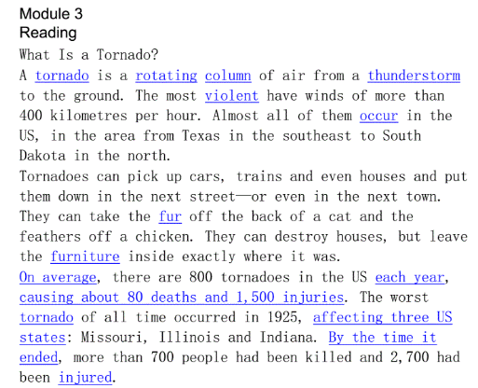
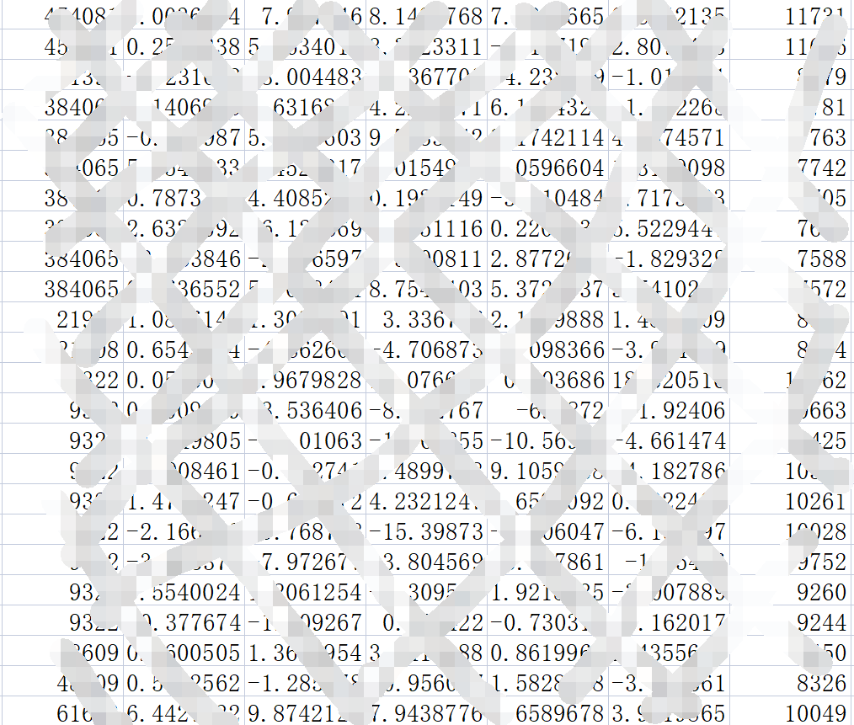
1. What is Relational Data
1.1 Data in daily life
Photos¹
Sounds¹
Text¹
Tabulars
[1] Photos are from bing.com

Slide 4

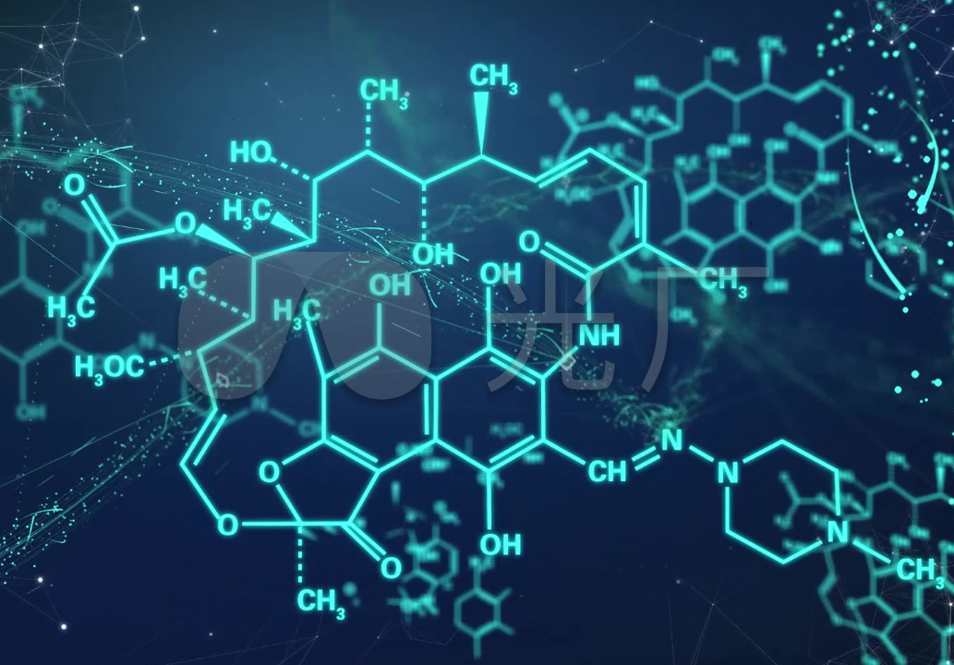
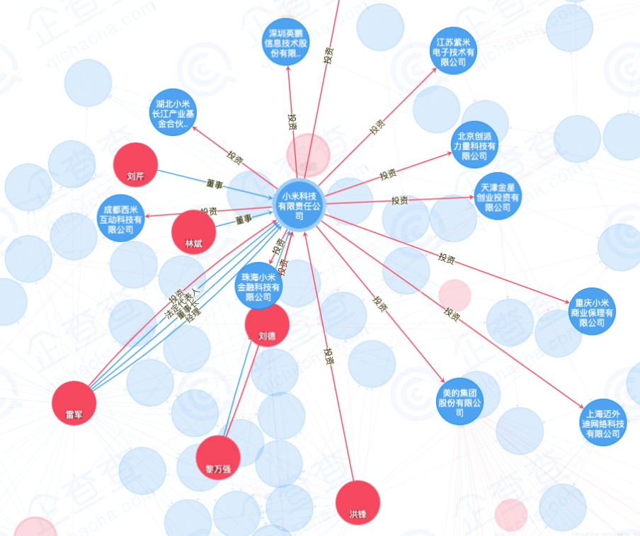
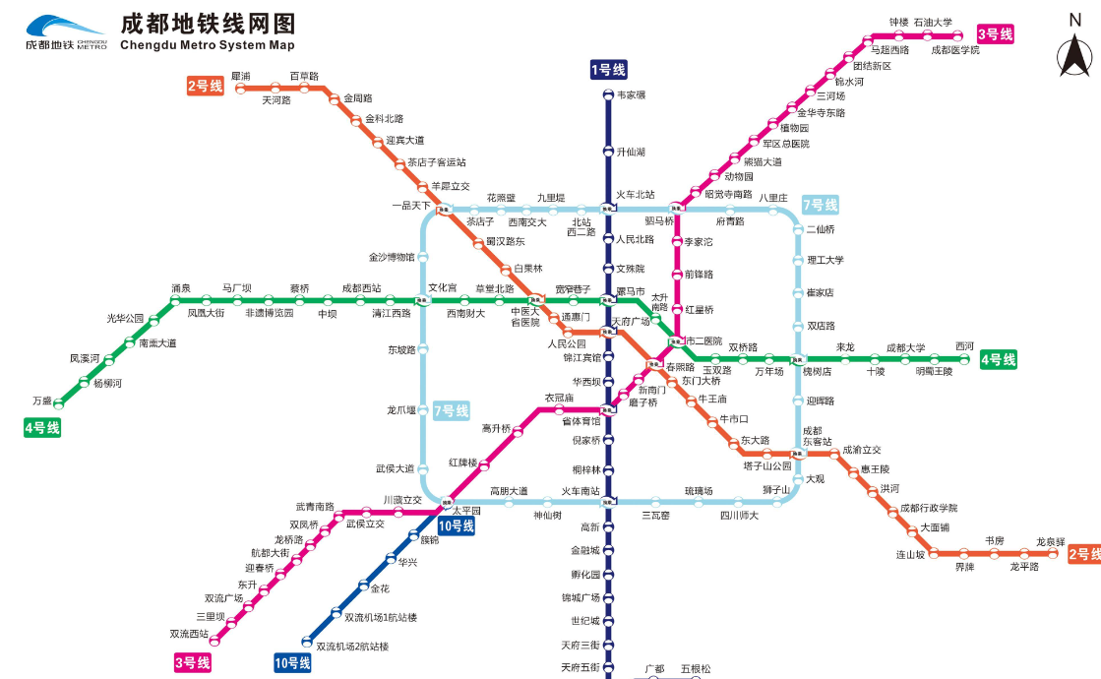
1. What is Relational Data
1.2 Relational Data
Social Networks¹
Chemical Molecules¹
Enterprise Data¹
Transportation Network¹
[1] Photos are from bing.com

Slide 5


1. What is Relational Data
1.3 Why is Relational Data more powerful?
1. Items are not independent, it ought have “neighbors”
²
Knowing some of his characteristics(play computers, otaku, sporty, fond of the social...), what are his hobbies?
Err, maybe drama chaser, or competition chaser, or gamer??
If we know that his friends are all fond of playing LOL&CSGO, so what are his hobbies?
Then I can confirm that his hobby is playing games!!
²
[2] Photos are from https://www.51pptmoban.com/sucai/6243.html

Slide 6

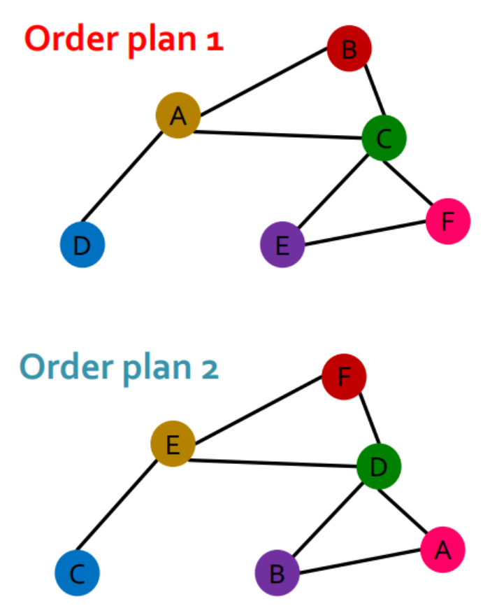
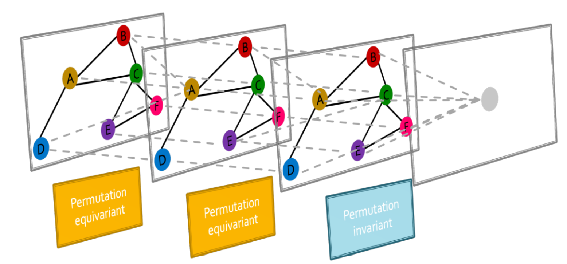
1. What is Relational Data
1.3 Why is Relational Data more powerful?
2. Graph Data is Non Euclidean and hold permutation equivariance.
Does “I Love You” equals to “You Love I” ?
X
X
=
³
Permutation Equivariant
[3] Pictures are from CS224W: Machine Learning with Graphs. http://web.stanford.edu/class/cs224w/

Slide 7
1. What is Relational Data
1.3 Why is Relational Data more powerful?
2. Graph is a general representation of Text & Image.
I Love You = I Love You
=

Slide 8
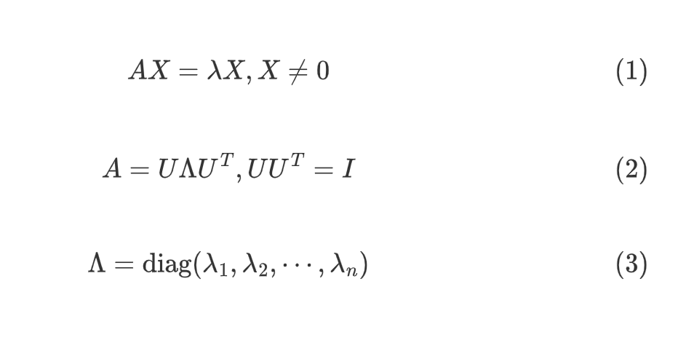
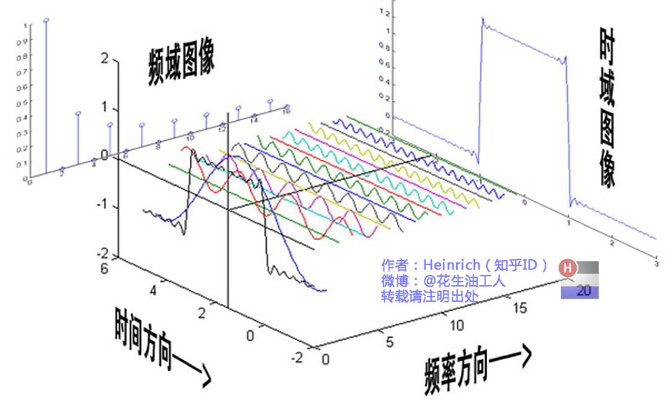
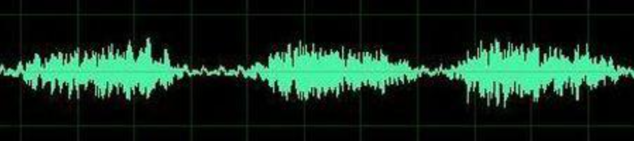
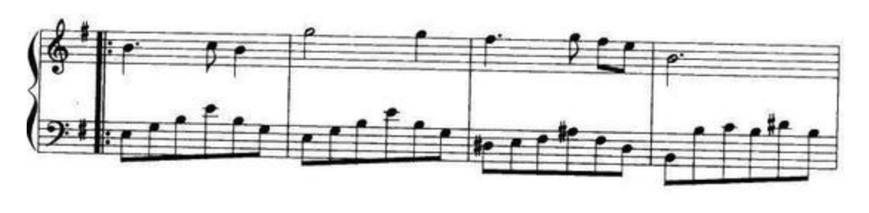
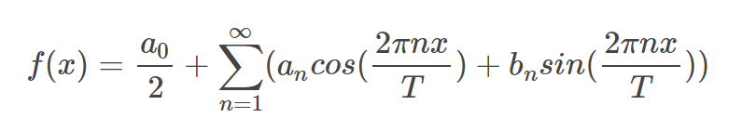
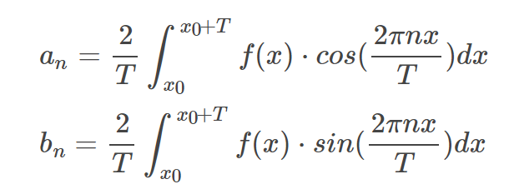
2. Adjacency Matrix and Graph
2.1 Review of Linear Algebra & Fourier Transform
Eigenvectors and Eigenvalue
Fourier Transform:
Time domain
Spectral domain
[3] Refer to https://zhuanlan.zhihu.com/p/19759362
Notes:
回忆当我们有了空间中一组正交基之后，我么可以把空间中的任意向量表示为这组基的线性组合：

Slide 9
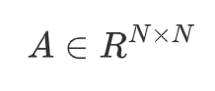
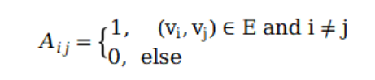
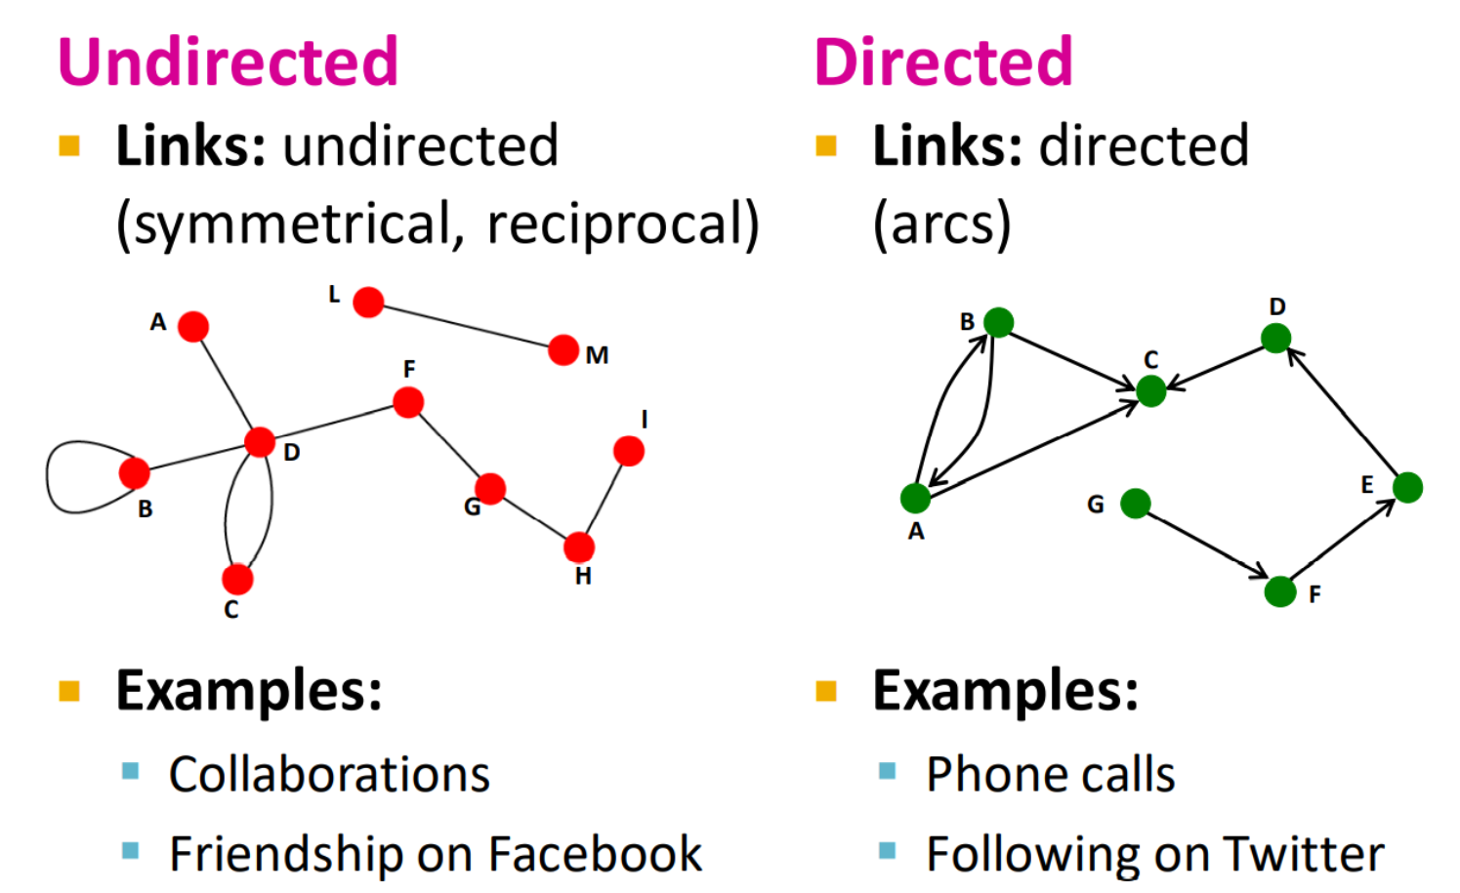
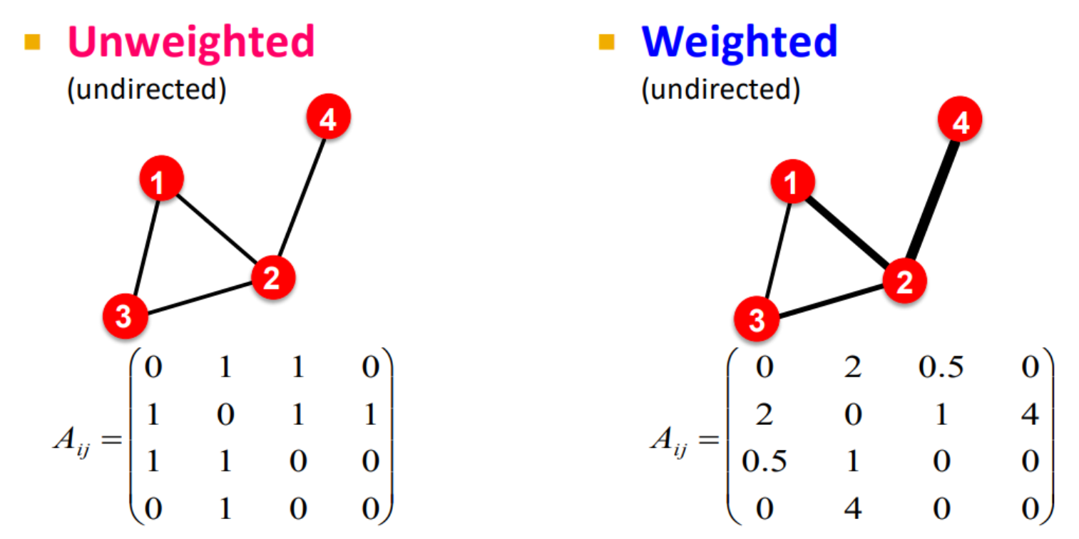
2. Adjacency Matrix and Graph
2.2 Adjacency Matrix
Suppose N nodes in a graph, A is a N*N matrix
³
³
[3] Pictures are from CS224W: Machine Learning with Graphs. http://web.stanford.edu/class/cs224w/

Slide 10
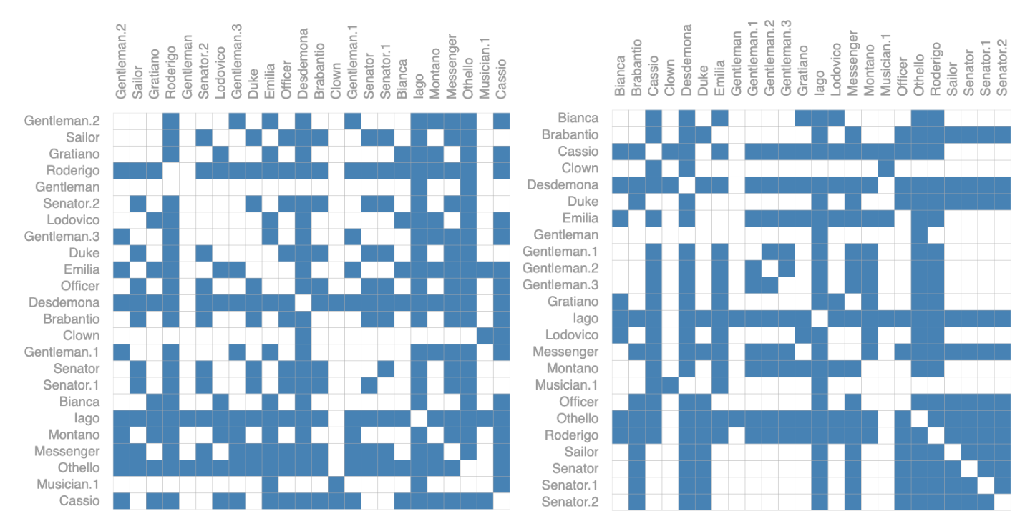
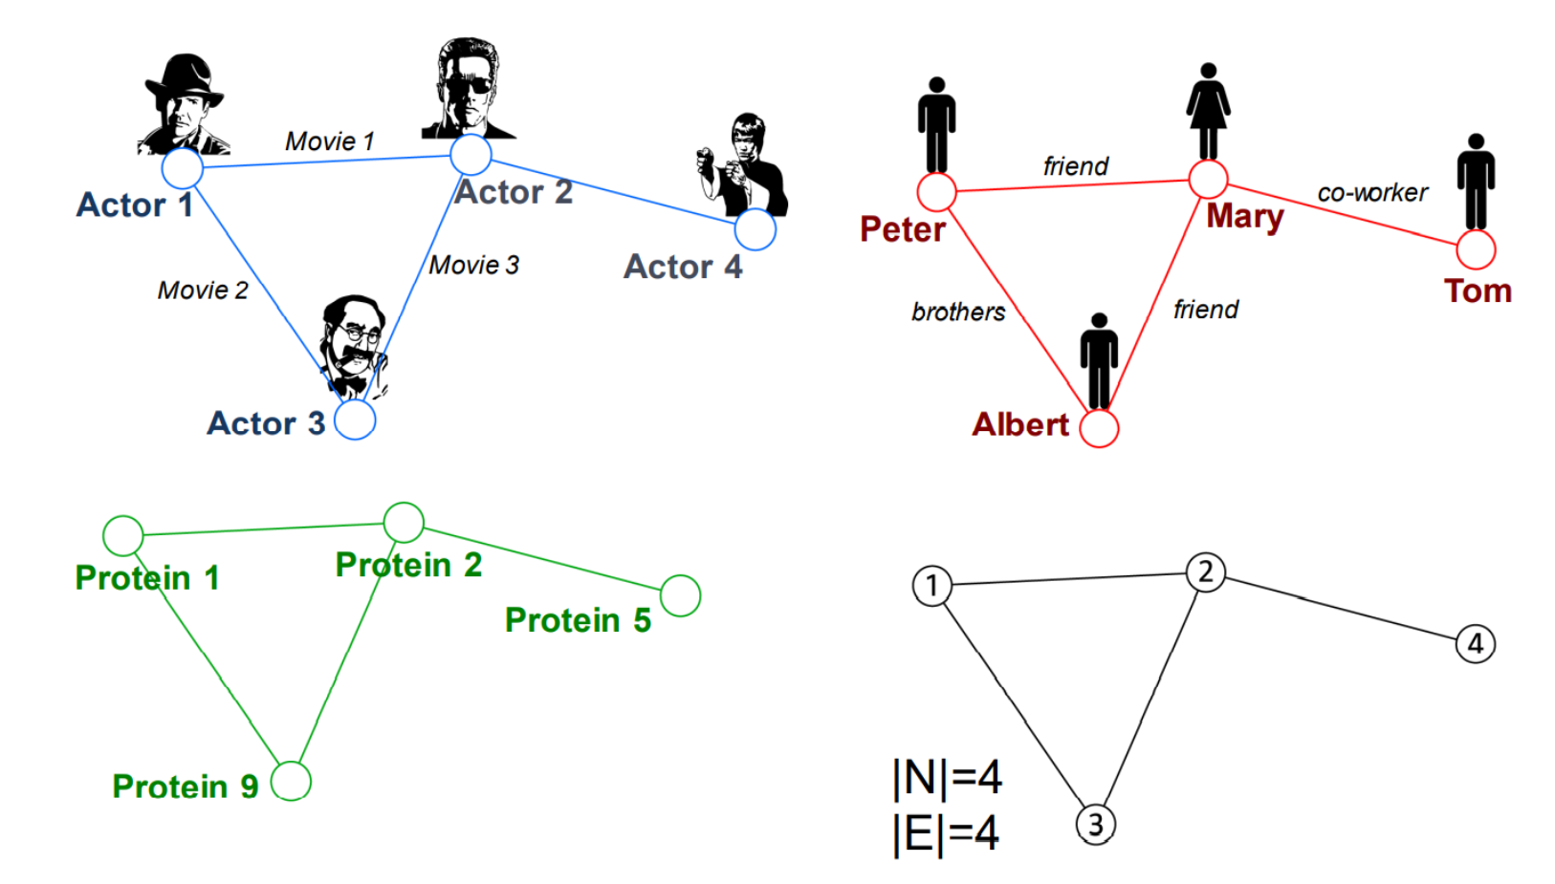
2. Adjacency Matrix and Graph
2.2 Adjacency Matrix
Modeling a real life problem as a graph
⁴
³
[3] Pictures are from CS224W: Machine Learning with Graphs. http://web.stanford.edu/class/cs224w/
[4] Pictures are from https://distill.pub/2021/gnn-intro/

Slide 11
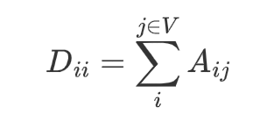
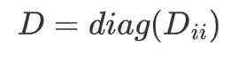
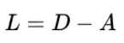
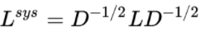
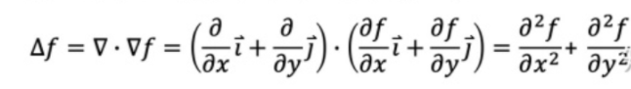
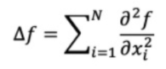
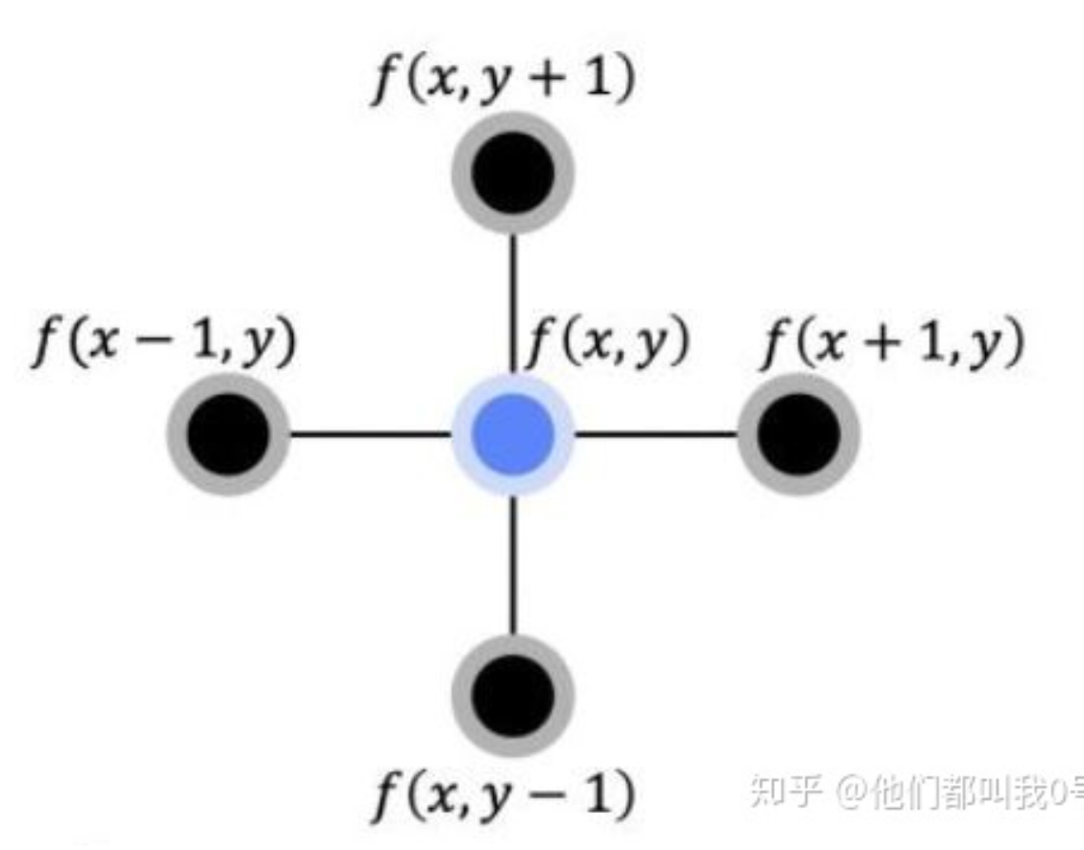
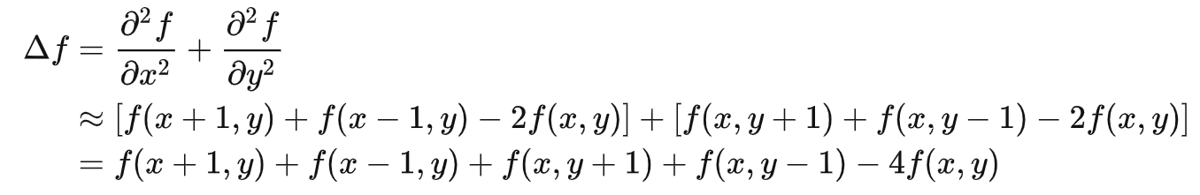

2. Adjacency Matrix and Graph
2.3 Degree Matrix and Laplacian Matrix
Degree Matrix
Laplacian Matrix / Symmetric Normalized Laplacian Matrix(semi-definite)
* Laplace operator:
sum of second derivative
for N variables
⁵
To discrete case
[5] From https://zhuanlan.zhihu.com/p/124727955?utm_source=wechat_timeline
Notes:
定义：拉普拉斯算子是n维欧几里德空间中的一个二阶微分算子

Slide 12
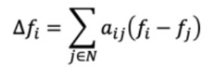
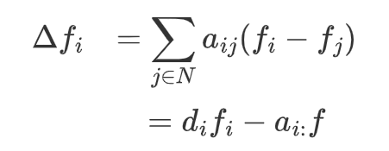
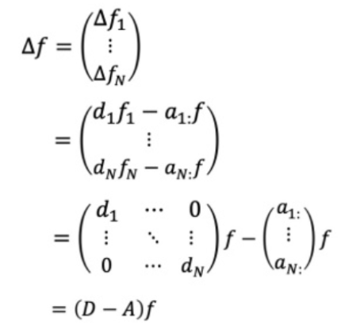
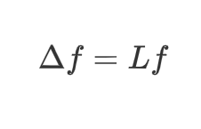
2. Adjacency Matrix and Graph
2.4 Laplace operator in graph:
For node i:
For the whole graph :
Notice that:
So that:
Consider undirected graph, Laplacian Matrix is real symmetric matrix(实对称矩阵)
N linear independent eigenvectors and orthogonal to each other（N个线性无关特征向量且相互正交）
Eigenvalue non negative（特征值非负）
Notes:
标量梯度场中的散度，一般可用于描述物理量的流入流出。

Slide 13
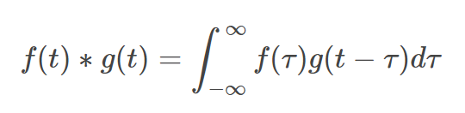
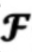
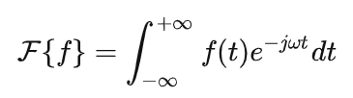
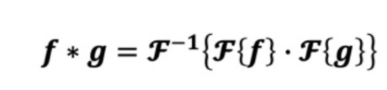
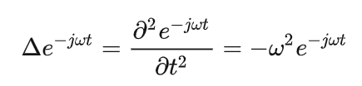
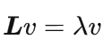
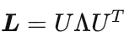
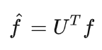
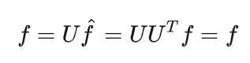
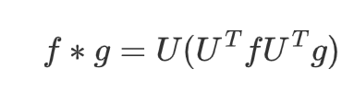
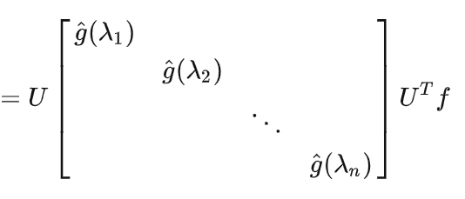
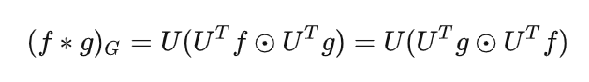
3. Fourier Transform on Graph
3.1 Convolution(*):
⁵
is Fourier Transform
Fourier basis
Review that Laplacian Matrix is real symmetric matrix:
So Flourier Transform in graph can be depicted as:
Convolution Kernel / Learnable parameters
We successfully do
convolution in graph
[5] Refer to https://zhuanlan.zhihu.com/p/124727955?utm_source=wechat_timeline
Notes:
如果有n阶矩阵 A，其矩阵的 元素 都为 实数 ，且矩阵A的 转置 等于其本身（a ij =a ji ）， (i,j为元素的脚标），则称A为实对称矩阵
卷积核一般也叫成滤波器，目的是提取特征

Slide 14
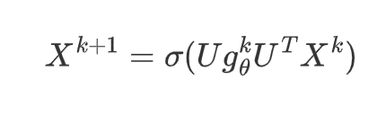
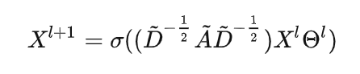
4. Graph Neural Network
4.1 GNN in Spectral Domain:
For a K layer Neural Network:
Activation Function
Feature in layer k+1
Learnable parameters in layer k
Later study proves that:
Laplacian Matrix

Slide 15
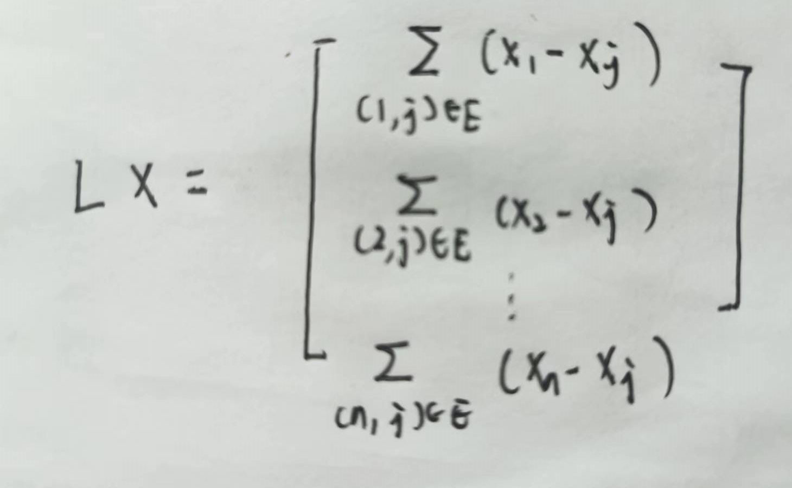
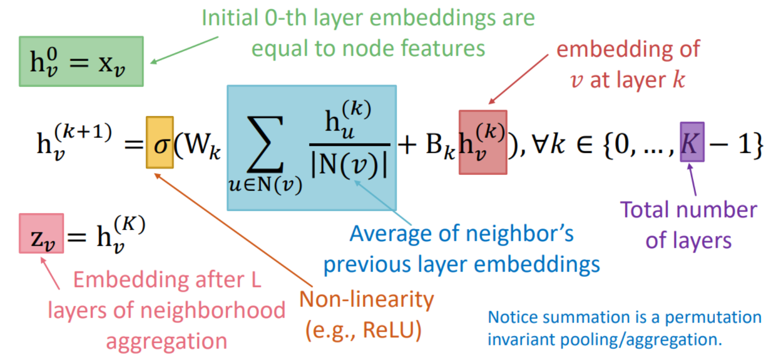
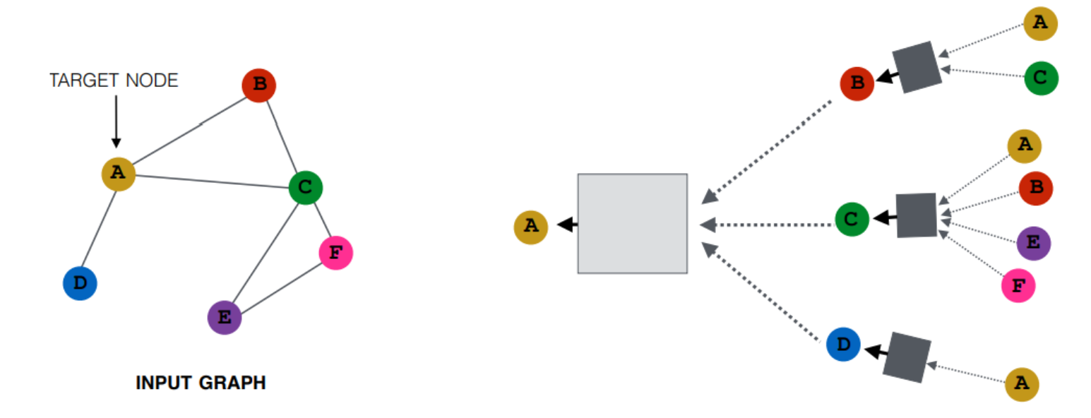
4. Graph Neural Network
⁷
4.2 GNN in Spatial Domain:
For a graph:
For every node:
⁶
Graph neural network can be regarded as a process of continuously aggregating neighbor information !!!
[6] Pictures are from CS224W: Machine Learning with Graphs. http://web.stanford.edu/class/cs224w/
[7] Refer to https://www.bilibili.com/video/BV1Vw411R7Fj?p=3&vd_source=fd3ebedaa3bcd36779a7cd2e29e73fcf

Slide 16
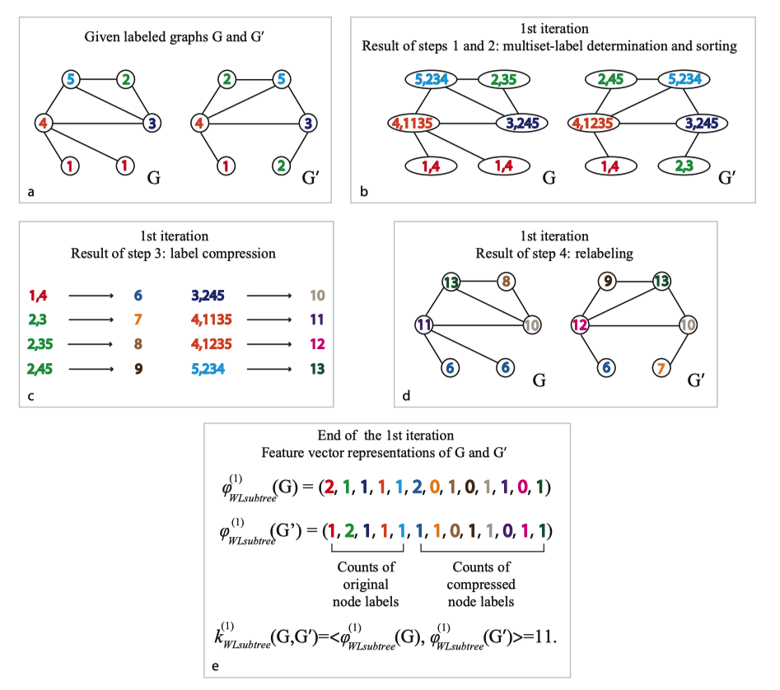
4. Graph Neural Network
4.3 Why do aggregate information works--Weisfeiler-Lehamn(WL) Test
Graph Isomorphism
⁷
1-d WL-Test
[7] Pictures are from https://zhuanlan.zhihu.com/p/384852087

Slide 17
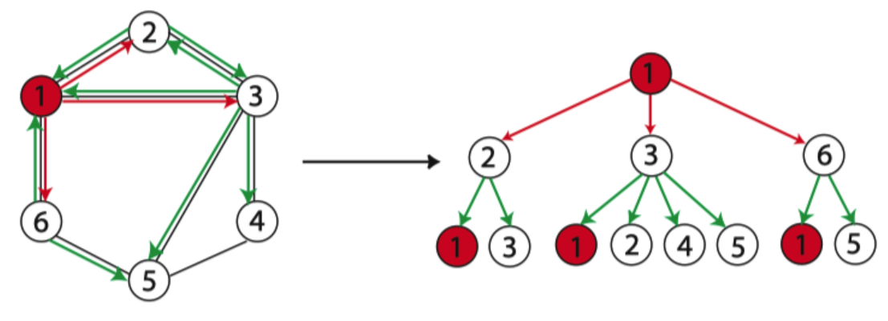



4. Graph Neural Network
4.3 Why do aggregate information works--Weisfeiler-Lehamn(WL) Test
⁷
K=3:
1-WL-Test:
1-MPNN:
MPNN's expressiveness upper bound is 1-WL test
WL-Test is a strong prove of GNN
[7] Pictures are from https://zhuanlan.zhihu.com/p/384852087
Notes:
如果GNN中Aggregate、Combine 和 Readout 函数是单射，GNN可以和WL test 一样强大

Slide 18






5. Graph Neural Network
5.1 GNN architecture
Aggregate information from nodes’ neighbors
GNN in node-level task

Slide 19





5. GNN Application
5.2 More study
GNN Weakness:
Need a pre-defined graph structures (i.e., adjacency matrix A)
If graph structure does not exist, KNN-based&Threshold-based methods are introduced to build adjacency and Laplacian matrices.
⁸
Solutions: SPGCL--a brand new adjacency matrix builder
[8] Refer to Mining Spatio-Temporal Relations via Self-Paced Graph Contrastive Learning. KDD2022

Slide 20


Slide 21
Thank you!

Slide 22
Notes:
回忆当我们有了空间中一组正交基之后，我么可以把空间中的任意向量表示为这组基的线性组合：

